Slide 1
DRB1*04 and tau interactions in the context of neurodegenerative disorders
Yoo Jin Jung, Mignot lab

Slide 2
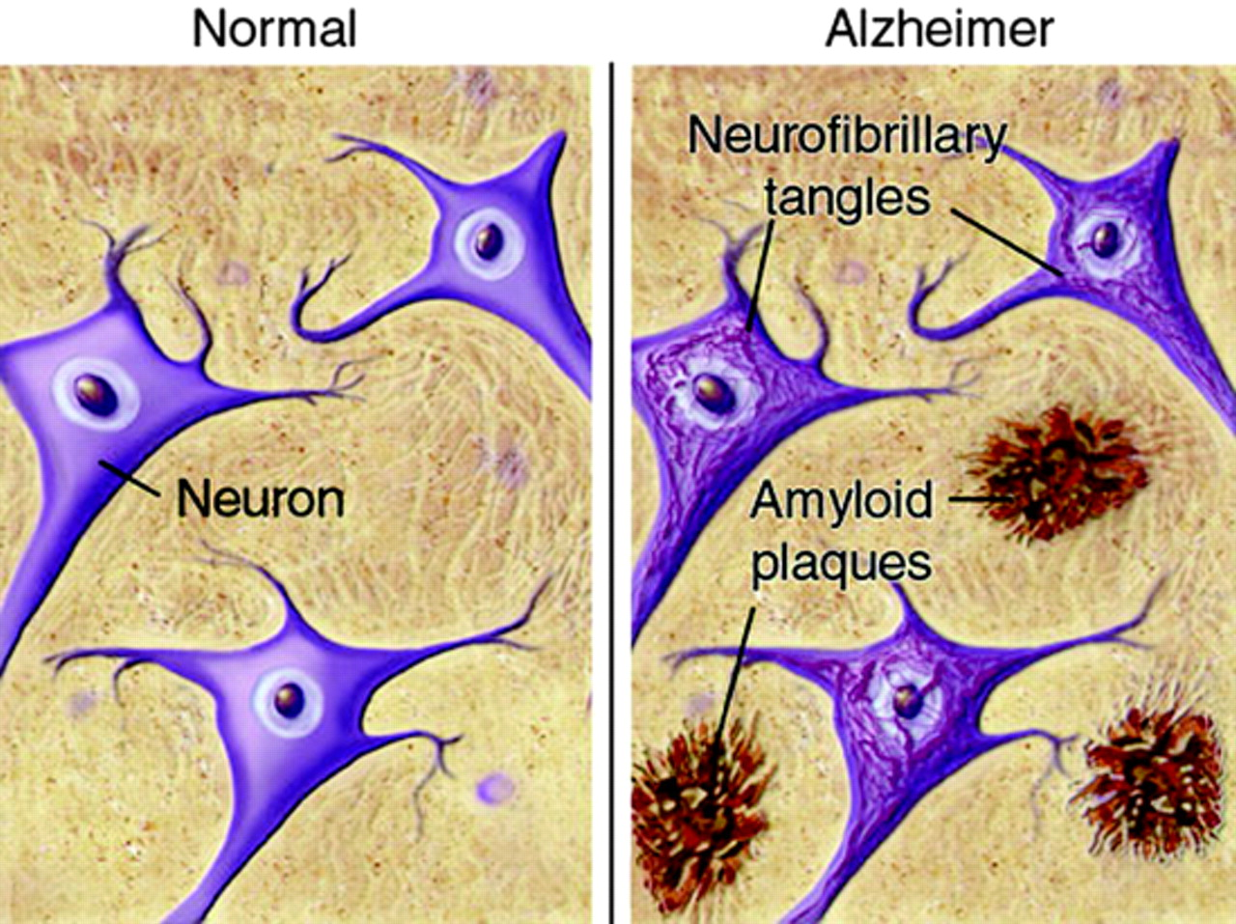
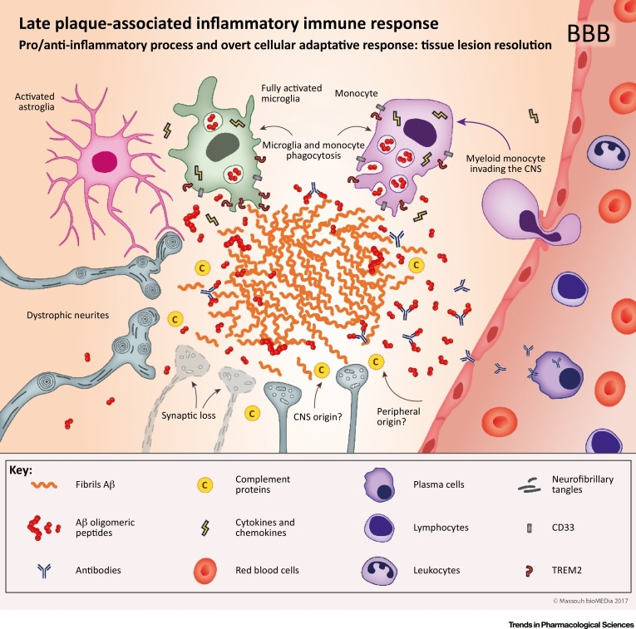
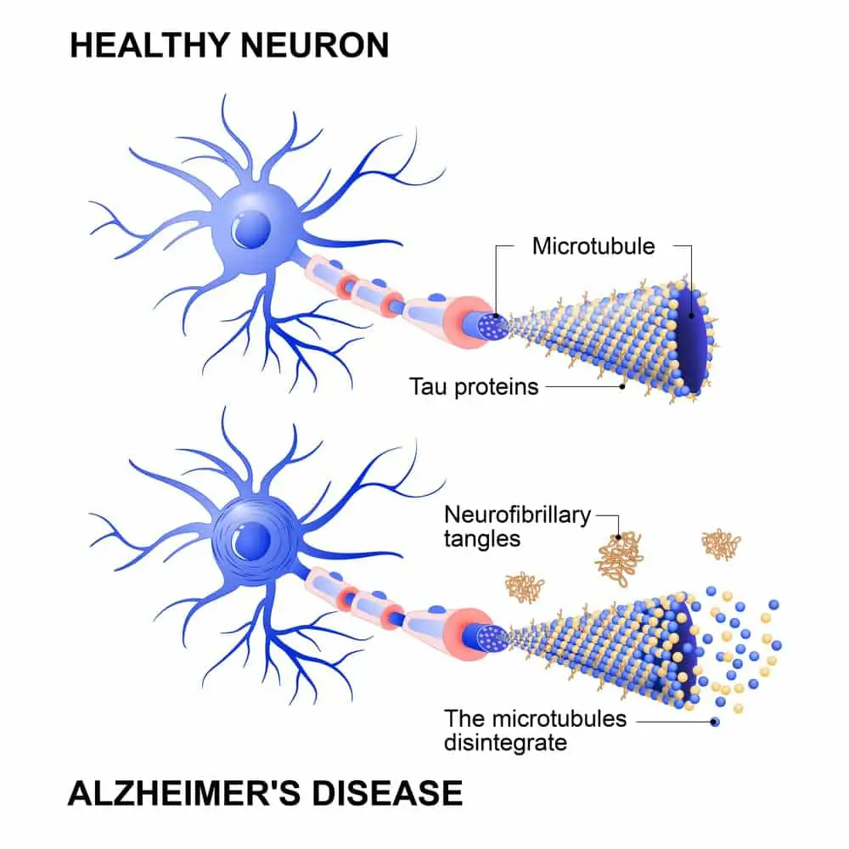
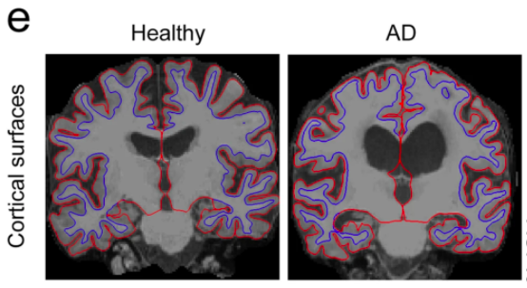
Background: Alzheimer’s disease (AD)
Gate et al. 2020, Nature
Notes:
Basics of some of the neurodegenerative disorders our project relates to.
AD is characterized by the presence of extracellular amyloid plaques made of Aβ peptides and intracellular NFTs made from hyperphosphorylated tau. Tau pathology generally happens after a-beta plaque formation and tau tangle and pTau levels are the most correlated with disease progression and cognitive deficits.
These plaques and tangles lead to dysfunction of neurons among other neural cell types, and lead to neuronal death. You can see in comparing healthy brain w/ AD brain, there are enlarged ventricles and loss of HC/cortical grey matter in AD brains (which is why we observe memory deficits as one of the most prominent features of the disease).
Inflammation is observed in AD patients (both in the CNS and in the periphery); activated MG are widely seen in AD post-mortem tissue, as well as in PET/MRI imaging. Inflam cytokine levels in Plasma and in peripheral tissues/organs like the gut are also higher in AD patients. Although it’s not clear what drives systemic inflammation and how this inflammation is connected to neurodegenerative processes, neuroinflammation in response to plaques/tangles is mainly driven by the innate immune cells of the brain- MG, although peripheral macrophage infiltration through the compromised BBB has also been observed.

Slide 3
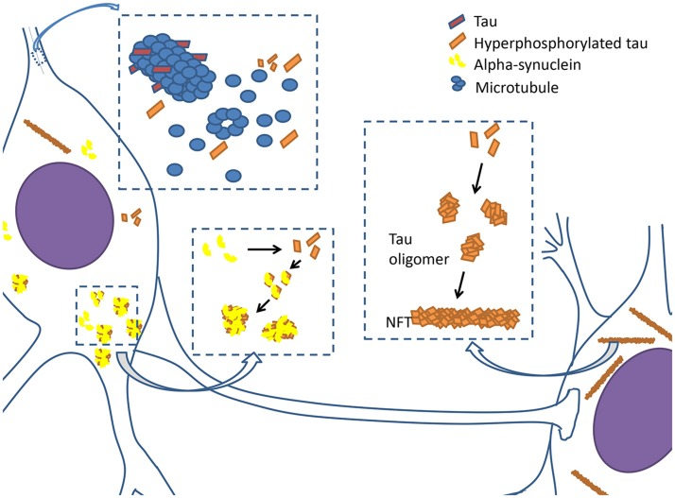
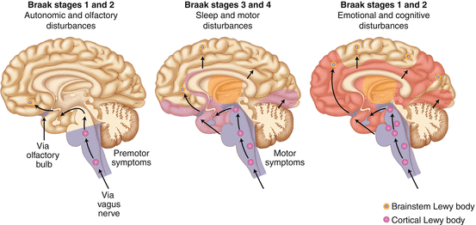
Background: Parkinson’s disease
Jellinger 2014, Inflammation in Parkinson's Disease
Zhang et al. 2018, Front Neurol
Notes:
Similar to AD: Tau proteins are hyperphosphorylated, they begin to disintegrate from microtubules (which they’re a building block for) and form oligomers and eventually neurofibrillary tangles (NFTs). Hyperphosphorylated tau proteins also interact with α-synuclein to promote aggregation and fibrilization each other, and form lewy bodies.
Lewy body aggregation spreads to various brain areas at different Braak stages. PD = characterized by the degeneration of dopaminergic neurons in the substantia nigra, but LBs actually start agg in the brainstem and then spread to the midbrain, where the substantia nigra, which produces dopamine, is located. Loss of dopaminergic cells leads to things like loss of motor control and behavioral disturbances.
Braak stages 1 & 2:
Lewy bodies in brainstem and lower brain
Symptoms: autonomic and olfactory disturbances
Braak stages 3 & 4:
Lewy bodies spread to midbrain and lower cortical regions
Symptoms: sleep and motor disturbances
Braak stages 5 & 6:
Lewy bodies spread to the rest of the cortex and throughout the brain
Symptoms: emotional and cognitive disturbances
Same as AD for inflammation:
T cell infiltration
Glial activation
Increased inflam cytokines systemically/in CNS

Slide 4
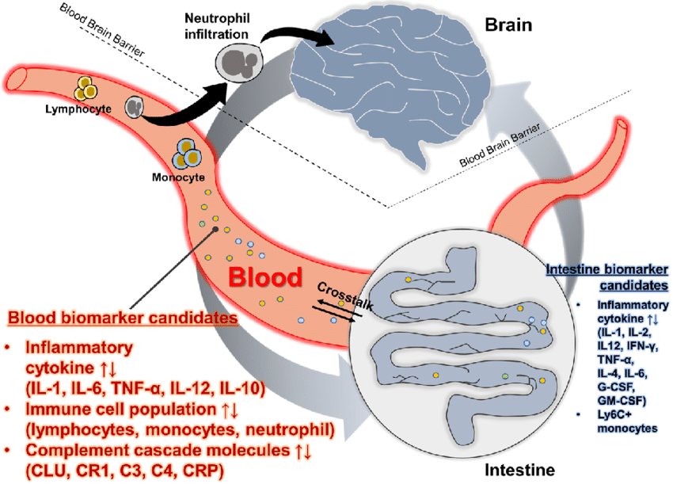
Background: tau and inflammation as the common source of pathology
Tau hyperphosphorylation is observed in AD, PD, and other tauopathies.
Chronic inflammation- neuroinflammation and systemic inflammation
Park et al., BMB Rep., 2020
Zhang et al. 2018, Front Neurol
Notes:
I won’t go over all of the different tauopathies we’re interested in, but the point is that tau tangles and inflammation are the common sources and symptoms of pathology in these disorders. Hyperphos of tau is especially to be noted in these disorders.
b/c chronic neuroinflammation is commonly observed in all of these neurodegenerative disorders, there’s abundant MG/astro research going on. And ofc there’s a lot of systemic inflammation in all of these neurodegenerative disorders too, BUT no one’s done a ton of research on adaptive immunity in the context of these disorders yet.
The AD and PD field have been focused on Abeta treatment for AD and a-syn treatment for PD, but not a lot of tau therapies have been developed/tested so far. There are a few tau antibodies that were developed in recent years and are currently being clinically tested, but even if the results aren’t promising, it could just be that the wrong tau isoforms are being targeted or we need a more specific/effective way to get rid of tau peptides that are aggregation-prone. (ex: use CAR-T cell therapy to target specific antigens)

Slide 5
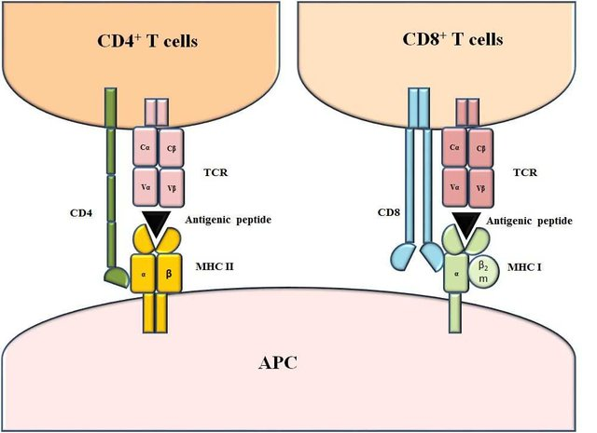
Background: TCRs, MHC II, APCs
Notes:
Before going into my project, I thought it’d be helpful to cover some basics of immunology that I learned while in the lab, b/c I don’t have an immunology background and had no idea what adaptive immunity was before rotating.
APCs have MHCs (major histocompatibility complex; HLAs) on their cell surface; there are 2 main categories of MHCs (MHC I/II) → binds peptides/antigens → presents them to T cells, which have unique TCRs on their cell surface.
If an antigen/peptide binds to the TCR as well, T cells are activated and produce an immune response. T cells that react to MHC II/peptide complexes are CD4+, while those that react to MHC I/peptide complexes are CD8+.

Slide 6
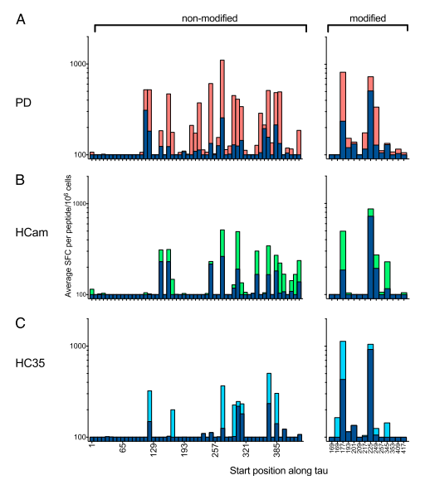
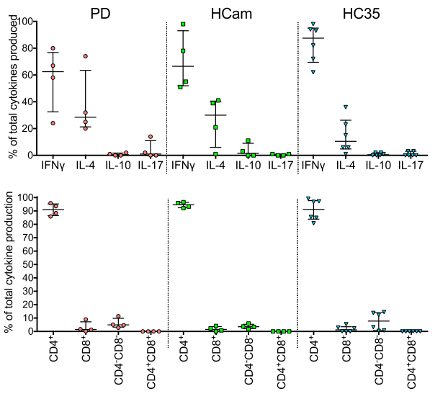
Inspiration for the project: autoimmunity to tau peptides
Lindestam Arlehamn et al., J Immun., 2020
Notes:
Sette paper:
PD possesses autoimmune features; PD is associated with T cell reactivity to a-syn and tau presented by MHC II.
PD patients and cntl subjects show T cell reactivity to tau peptides that are commonly found in PD tauopathy, and Inflammatory responses are driven by CD4+ T cells.
Many tau peptides (both with and without modifications) induce an autoimmune response in PD patients and non-patients, but phosphorylated sequences seem to induce more freq immune responses in both PD/cntl subjects for some of the peptides they tested.
Tau induces more of an immune response than a-syn in PD patients and induces equally strong responses in cntl subjects too (while a-syn only induce responses in PD).
These findings indicate there’s some sort of immune response that’s possibly protective against AD/PD. This immune response could be driven by DRB1*04, potentially by DR4 binding to peptides (probably tau) implicated in AD/PD to decrease protein aggregation.
BUT no one’s done a ton of research on adaptive immunity in the context of these disorders yet.
Also interesting to note that chronic neuroinflammation is commonly observed in all of these neurodegenerative disorders, which is why there’s abundant MG/astro research going on.

Slide 7
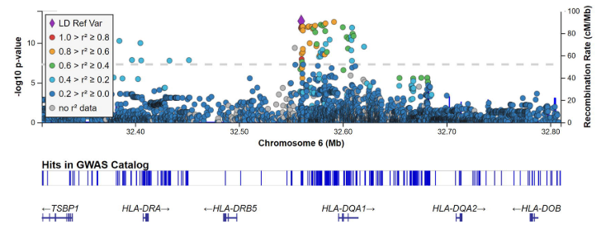
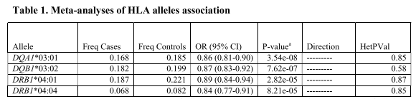
Inspiration for the project: GWAS meta-analyses show DRB1*04 subtypes protect against PD
Rs112485576
Allele | CASES% | CTRLS% | OR (95% CI) | P-VALUE | DIR | HETPVAL
DRB1*04:01 | 0.187 | 0.221 | 0.89 (0.84-0.94) | 2.82e-05 | --------- | 0.87
DRB1*04:04 | 0.068 | 0.082 | 0.84 (0.77-0.91) | 8.21e-05 | --------- | 0.85
DRB1*04 13H | 0.289 | 0.331 | 0.87 (0.83-0.91) | 4.32e-09 | --------- | 0.60
DRB1*04 33H | 0.289 | 0.331 | 0.87 (0.83-0.91) | 4.32e-09 | --------- | 0.60
DRB1*04 11V | 0.302 | 0.342 | 0.87 (0.83-0.91) | 8.22e-09 | --------- | 0.45
Allele | CASES% | CTRLS% | OR (95% CI) | P-VALUE | DIR | HETPVAL
DRB1*04:03 | 0.054 | 0.068 | 0.79 (0.65-0.93) | 1.16e-03 | --+-+ | 0.29
DRB1*04:03 / DRB1*04:06 | 0.099 | 0.112 | 0.82 (0.71-0.93) | 3.52e-04 | --+-+ | 0.47
DRB1*04 (excl 04:05/04:10/) | 0.112 | 0.120 | 0.83 (0.73-0.93) | 4.85e-04 | ----+ | 0.70
DRB1*04:05 / DRB1*04:10 | 0.132 | 0.119 | 0.98 (0.82-1.14) | 0.756 | ?-?-? | 0.95
Yu et al., medRxiv, 2020
Notes:
TBH i’m not super familiar with this data, so correct me at any point if I’m wrong, but to my understanding,
Our lab did a large-scale GWAS meta-analyses of HLA types in close to 40K PD patients and cntl subjects, which is the largest meta-analysis performed for HLAs. We found...
Rs112485576, the top associated SNP/GWAS hit in the HLA locus (single nucleotide polymorphism), which had been previously associated with HLA-DRB5 is actually driven by 3 aa changes (11V, 13H, and 33H) w/i HLA-DRB1*04 (I’ll call this DR4)
Found 4 HLA alleles that were associated with PD (it is likely that these associations are driven by DRB1.)
Caucasians: 04:01, 04:04 and related subtypes of DRB1*04 are protective against PD (04:01 was the most common DR4 in this sample)
Asians: 04:03 (homo to 04:01? Not sure if there’s any known relationship b/w 0403 and 0401), 04:06 is protective, but 04:05/04:10 is not.
From my understanding, similar findings were also found recently in AD/FTD patient GWAS meta-analyses as well.

Slide 8
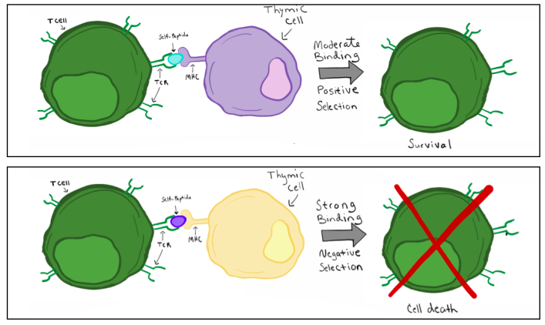
Background: T cell selection in the thymus
DRB*04 binds pTau
→ pTau cleared
→ no tau aggregation
Notes:
Another part of adaptive immunity that is crucial to the hypot underlying my project is the role of T cell selection in the thymus, which is where mature T cells are formed.
Thymus helps to get rid of T cells that strongly bind and react to self-peptides to prevent an autoimmune response, but T cells that recognize peptides with PTMs or bind weakly/moderately aren’t negatively chosen against. So we think that maybe tau peptides with PTMs that are more prone to aggregation form MHC II/peptide complex (specifically with DR04:01 or other protective HLA alleles- 0403, 0406, 0404) and are recognized by T cells and cleared, thereby protecting against tauopathies.

Slide 9
Project overview
Screen tau peptides to choose those that bind strongly to DRB1*04:01 (and maybe not to DRB1*04:05).
Peptide binding assay (TRF, bio-GAD, non-bio DR)
TR-FRET (DNP-CMV)
Used flow cytometry to test which DNP-peptide bound best to both types of DR
Tetramer/dextramer formation and incubation with PBMCs (control, patients)
TCR reactivity from tetramer can be detected with flow cytometry, with PE+ (tetramer present) and FITC+ (CD4 marker).
Single cell TCR sequencing of PE+/FITC+ cells’ TCR alpha/beta chains
Transfect jurkat cells with TCR relevant clones
Jurkat TCR + APC (w/ DR4) + tau peptide
Check TCR reactivity by looking at luciferase
Notes:
Based on Guo’s study of HLA-DQ and HA/orexin peptides.
In vitro screen of a-syn and tau peptides to choose peptides that bind to protective HLA types (here we’re using 04:01) and don’t bind to non-protective HLAs.
We did look at both a-syn and tau, but we think tau is more likely to be what causes T cell reactivity in AD/PD patients, bc it’s implicated in both diseases and because the Sette paper found tau has 3 times higher response frequency in PD patients than a-syn
This is where I spent most of my time, b/c there was a lot of trouble-shooting to do; DR didn’t bind as well to peptides as DQ does, so we had to find competitor peptides that we could use for this peptide displacement assay. But the next steps will be really interesting-
We’re planning to get cntl/PD patient PBMCs (I think from AD patients too) and incubating them with DR04:01/tau peptide tetramer complexes.
From those, we’ll choose the CD4+ activated T cells that are bound and activated by the tetramers and will do TCR seq to get the exact seq of the a/b chains of the TCRs that recognize tau peptides.
We’ll clone these TCRs into cells to do in vitro verification studies showing that these TCRs recognize and are activated by DR4/tau peptide complexes.

Slide 10
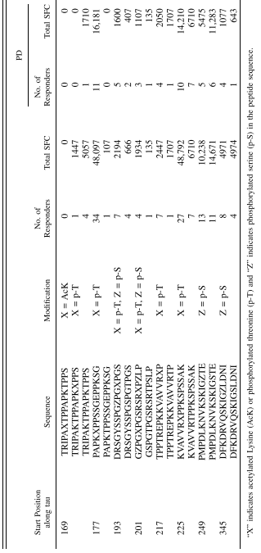
Peptide generation
Test the entire protein (a-syn, tau) with 11 overlapping 15-mers.
We did this for a-syn, not for tau
A-syn = 67 peptides total
Tau = 76 peptides total
PTMs: some PMTs known to be associated with PD/AD pathology.
Lindestam Arlehamn et al., J Immun., 2020
Notes:
For our peptide screen, we generated tau peptides some WT, some with PTMs implicated in early stages of AD/PD. We had 67 a-syn and 76 tau
phosphorylated sequences seem to induce more freq immune responses in both PD/cntl subjects for some of the peptides they tested.

Slide 11
DRB1*04:01 and *04:05 binding predictions (NetMHCII 4.0)
Peptide | ID | Target | Core | Score | Rank | Score_BA | nM | 0401 Rank_BA | Binder type | 0405 rank_BA
VQIVYKPVDLSKVTS | Sequence | -99.999 | IVYKPVDLS | 0.194166 | 7.12 | 0.469732 | 310.251169 | 6.87 | SB | 10.05
SVQIVYKPVDLSKVTS | Sequence | -99.999 | IVYKPVDLS | 0.273221 | 5.06 | 0.403746 | 633.548199 | 14.76 | SB | 17.87
SRLQTAPVPMPDLKNV | Sequence | -99.999 | LQTAPVPMP | 0.009384 | 39.88 | 0.322523 | 1525.61202 | 32.41 | WB | 41.67
LATLADEVSASLAKQG | Sequence | -99.999 | LADEVSASL | 0.024488 | 26.53 | 0.320585 | 1557.93992 | 32.94 | WB | 48.44
MAEPRQEFEVMEDHAG | Sequence | -99.999 | FEVMEDHAG | 0.363647 | 3.49 | 0.319796 | 1571.29668 | 33.15 | WB | 23.28
DQGGYTMHQDQEGDTD | Sequence | -99.999 | YTMHQDQEG | 0.738904 | 0.66 | 0.314467 | 1664.55827 | 34.56 | WB | 50.29
GKVQIINKKLDLSNVQ | Sequence | -99.999 | IINKKLDLS | 0.040607 | 20.66 | 0.301102 | 1923.53786 | 38.33 | WB | 41.1
KSKIGSTENLKHQPGG | Sequence | -99.999 | IGSTENLKH | 0.243368 | 5.73 | 0.298664 | 1974.95328 | 39.01 | WB | 53.5
ATLADEVSASLAKQGL | Sequence | -99.999 | LADEVSASL | 0.011935 | 36.32 | 0.289536 | 2179.96251 | 41.77 | WB | 57.6
VYKSPVVSGDTSPRHL | Sequence | -99.999 | VSGDTSPRH | 0.053958 | 17.64 | 0.265634 | 2823.34406 | 49.16 | WB | 71.63
KIGSLDNITHVPGGGN | Sequence | -99.999 | LDNITHVPG | 0.036588 | 21.81 | 0.26367 | 2883.98225 | 49.76 | WB | 50.4
Notes:
While we waited on getting the peptide binding assay to work, we ran the peptides through MHC II binding prediction programs online.
I used NetMHCIIpan 4.0 to predict binding affinity for 04:01 and 04:05 and our tau peptides.
Pretty accurate predictors of DR binding. combines experimental ligand binding affinity data for a subset of peptides with a machine-learning strategy (instead of just one) (Reynisson 2020) to predict which peptides would bind well to 04:01 but not to 04:05.
There was a list of 26 peptides that were predicted to bind according to the thresholds I set to determine strong/weak binders. But generally there isn’t a huge difference between predicted binding affinity for 04:01 vs 04:05, so we really need to do experiments to determine which peptides bind 4:01 and activate T cells.

Slide 12
Core 9-mer sequence and MHC II-binding residues of strong/weak binders
Core | 1 | 2 | 3 | 4 | 5 | 6 | 7 | 8 | 9 | red = HLA-binding
IVYKPVDLS | I | V | Y | K | P | V | D | L | S
IVYKPVDLS | I | V | Y | K | P | V | D | L | S
LQTAPVPMP | L | Q | T | A | P | V | P | M | P
LADEVSASL | L | A | D | E | V | S | A | S | L
FEVMEDHAG | F | E | V | M | E | D | H | A | G
YTMHQDQEG | Y | T | M | H | Q | D | Q | E | G
IINKKLDLS | I | I | N | K | K | L | D | L | S
IGSTENLKH | I | G | S | T | E | N | L | K | H
LADEVSASL | L | A | D | E | V | S | A | S | L
VSGDTSPRH | V | S | G | D | T | S | P | R | H
LDNITHVPG | L | D | N | I | T | H | V | P | G

Slide 13
pSer replaced with aspartic acid (D)
Peptide | DRB1_0401 rank | DRB1_0405 rank | Core
PMPDLKNVKSKIGDTE | 7.68 | 10.75 | LKNVKSKIG
KSKIGDTENLKHQPGG | 15.32 | 18.97 | IGDTENLKH
VYKDPVVSGDTSPRHL | 15.71 | 32.08 | VSGDTSPRH
KIGDLDNITHVPGGGN | 18.98 | 27.25 | LDNITHVPG
Core | 1 | 2 | 3 | 4 | 5 | 6 | 7 | 8 | 9 | red = HLA-binding
LKNVKSKIG | L | K | N | V | K | S | K | I | G
IGDTENLKH | I | G | D | T | E | N | L | K | H
VSGDTSPRH | V | S | G | D | T | S | P | R | H
LDNITHVPG | L | D | N | I | T | H | V | P | G

Slide 14
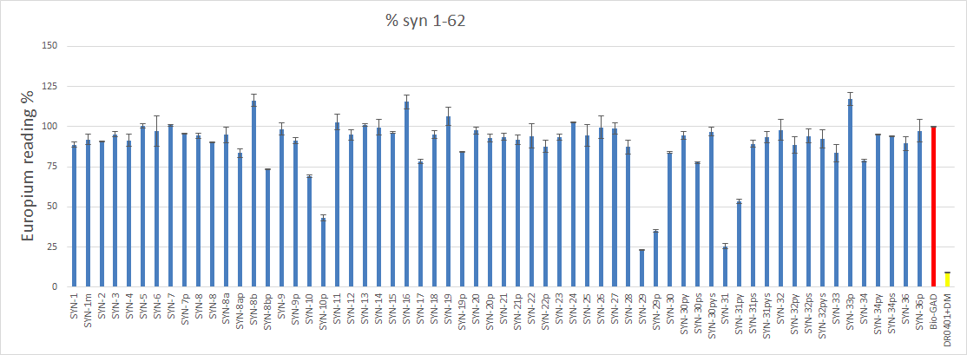
DELFIA peptide binding results (a-syn)
Courtesy of Guo Luo
Notes:
These are results from our in vitro peptide binding experiments.
Guo tested the a-syn peptides with 04:01 and found a few strongly binding peptides. The y axis shows how much bio-GAD is bound to DR04:01 (compared to a + cntl with no tau and just bio-GAD). The less the bio-GAD, the more we can assume the competing tau peptide displaced GAD to bind DR in its place.

Slide 15
Some characteristics of high-binders vs non-binders (alpha-synuclein)
Peptide | 9-mer Core | Sequence | Post- translational modification | % GAD signal
SYN-29 | MPVDPDNEA | LEDMPVDPDNEAYEM |  | 23
SYN-29p | MPVDPDNEA | LEDMPVDPDNEAY(p)EM | pY125 | 35
SYN-31 | AYEMPSEEG | DNEAYEMPSEEGYQD |  | 26
SYN-31ps | AYEMPSEEG (P6) | DNEAYEMPS(p)EEGYQD | pS129 | 89
SYN-31py | AYEMPSEEG (P2) | DNEAY(p)EMPSEEGYQD | pY125 | 53
Notes:
pS129 and pY125 seem to decrease binding of a-syn to HLA-DR04:01, and it seems S129 and Y125 are important for strong binding to HLA.
(GAD = competing protein w/ high affinity for HLA)
Y= tyrosine

Slide 16
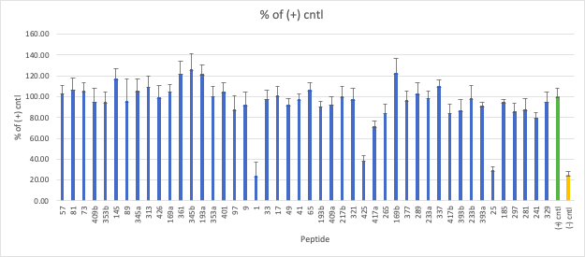
DELFIA peptide binding assay results (tau)
Notes:
These are my results for tau. I also found a select few tau peptides that bound strongly.
1:400
bio-GAD: tau peptide
Seems like the following peptides bind well:
1
425
25
369

Slide 17
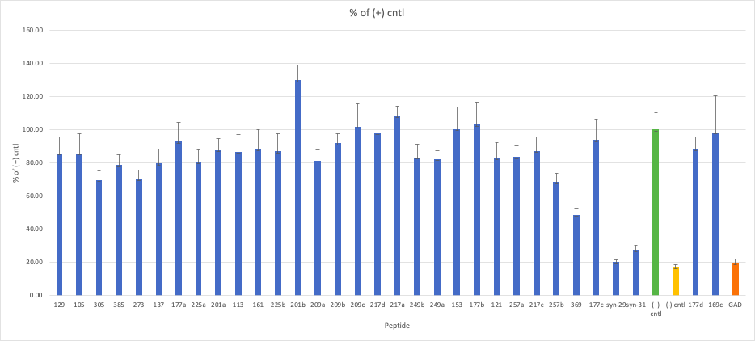
DELFIA peptide binding assay results (tau)
Notes:
This is a continuation of the peptides, with strongly binding a-syn peptides and non-bio GAD as extra negative controls.
1:400
bio-GAD: tau peptide

Slide 18
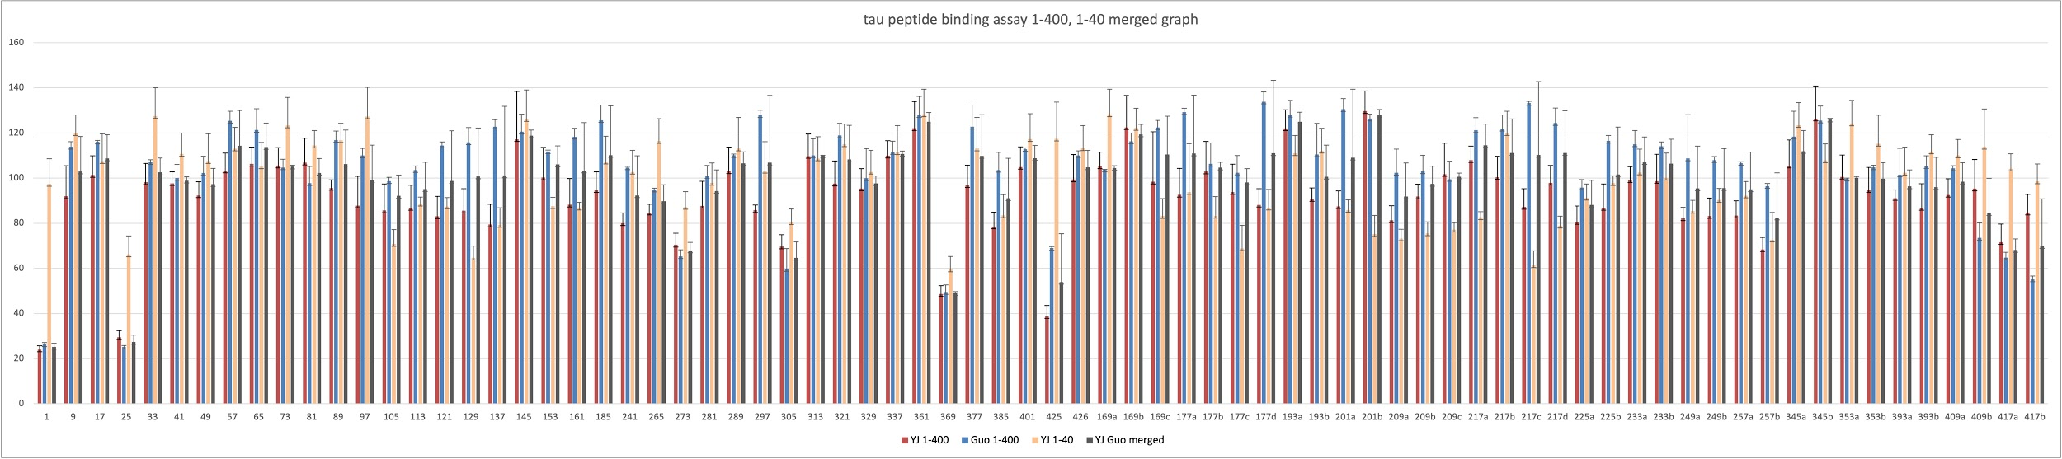
Merged tau binding affinity data
Merged results show the following tau peptides bind best:
1: MAEPRQEFEVMEDHAG
25: DQGGYTMHQDQEGDTD
369: KKIETHKLTFRENAKA
425: LATLADEVSASLAKQG
Notes:
Guo and I did separate assays for tau and had fairly similar results; this shows our combined data and it seems tau 1, 25, 369, and 425 bind the best to DR04:01.
It’s good to note that these results are based on tau’s ability to displace a very strongly binding protein- GAD, which was even predicted to be an ultra strong binder using the online prediction program.

Slide 19
Some characteristics of high-binders vs non-binders (tau)
name | sequence | Core | % of (+) cntl
425 | LATLADEVSASLAKQG | LADEVSASL | 38.84
426 | ATLADEVSASLAKQGL | LADEVSASL | 99.41
name | sequence | Core | 1 | 2 | 3 | 4 | 5 | 6 | 7 | 8 | 9
1 | MAEPRQEFEVMEDHAG | FEVMEDHAG | F | E | V | M | E | D | H | A | G
25 | DQGGYTMHQDQEGDTD | YTMHQDQEG | Y | T | M | H | Q | D | Q | E | G
369 | KKIETHKLTFRENAKA | LTFRENAKA | L | T | F | R | E | N | A | K | A
425 | LATLADEVSASLAKQG | LADEVSASL | L | A | D | E | V | S | A | S | L
Notes:
These peptides didn’t have phos counterparts, so it’s hard to compare and figure out the most important binders like we did w/ a-syn.
RED: pockets of the binding core (1, 4, 6, 9) that are part of the MHC II binding groove and bind HLA. This core region interaction largely determines binding affinity and specificity. But aa residues flanking the core region also make contact with the MHC molecule outside of the binding groove, and contribute to MHC-peptide interaction (Wang 2008).
It seems like there could characteristics like P1/9 residues of strong binders being neutral, but P4/6 seem to vary in polarity or charge. (ex: P4 = all charged/polar except M, P6 = D is polar, others neutral)

Slide 20
MixMHC2pred is a good predictor of HLA-DR peptide binding
Peptide # | Sequence | Core_best | %Rank_DR0401
1 | MAEPRQEFEVMEDHAG | FEVMEDHAG | 1.25
25 | DQGGYTMHQDQEGDTD | YTMHQDQEG | 4.33
305 | SVQIVYKPVDLSKVTS | IVYKPVDLS | 4.85
273 | GKVQIINKKLDLSNVQ | VQIINKKLD | 6.92
393b | VYKDPVVSGDTSPRHL | VSGDTSPRH | 6.97
393a | VYKSPVVSGDTSPRHL | VSGDTSPRH | 7.05
425 | LATLADEVSASLAKQG | LADEVSASL | 7.57
145 | ADGKTKIATPRGAAPP | KTKIATPRG | 8.5
401 | GDTSPRHLSNVSSTGS | PRHLSNVSS | 10.9
369 | KKIETHKLTFRENAKA | LTFRENAKA | 11.2
Notes:
I tried a few different predictors, and based on the results, I found the MixMHC2 program was the best predictor.
These are the top HLA binders using MixMHC2 program, and all 4 of the top binders were in the top 10 peptides. So maybe we could use this before ordering more peptides.

Slide 21
name | sequence | Core | % of (+) cntl
177a | PAPK{pThr}PPSSGEPPKSG | PSSGEPPKS | 92.63
177b | PAPKTPPSSGEPPKSG | PSSGEPPKS | 102.93
177c | PAPK{PTHR}PPSSGEPPK{PSER}G | PSSGEPPKD | 93.78
177d | PAPKTPPSSGEPPK{PSER}G | PSSGEPPKD | 88.17
193a | DRSGYSSPG{pSer}PG{pThr}PGS | YSSPGDPGG | 122.01
193b | DRSGYSSPGSPGTPGS | YSSPGSPGT | 90.70
201a | G{pSer}PG{pThr}PGSRSR{pThr}P{pSer}LP | PGSRSRGPD | 87.51
201b | GSPGTPGSRSRTPSLP | PGSRSRTPS | 129.67
209a | RSRTPSLPTPPTREPK | SLPTPPTRE | 81.33
209b | RSR{pThr}P{pSer}LPTPPTREPK | RGPDLPTPP | 91.82
209c | RSR{pThr}PSLP{pSer}PPTREPK | SLPDPPTRE | 101.75
217a | TPPTREPKKVAVVR{pThr}P | PKKVAVVRG | 107.96
217b | TPPTREPKKVAVVRTP | PKKVAVVRT | 100.44
217c | TPP{PTHR}REPKKVAVVR{PTHR}P | PKKVAVVRG | 87.21
217d | TPP{PTHR}REPKKVAVVRTP | PKKVAVVRT | 97.93
225a | KVAVVR{pThr}PPKSPSSAK | VRGPPKSPS | 80.47
225b | KVAVVRTPPKSPSSAK | VVRTPPKSP | 86.76
Notes:
This is a list of some of the tau peptides with PTM counterparts.
In most situations, just like with a-syn, PTMs decreased binding affinity to DR, but some PTMs increased binding compared to non-phosphorylated forms. We’re interested in these b/c of our theory that peptides with PTMs aren’t negatively selected against by the thymus, and tau peptides with hyperphosphorylation are the ones that are typically found in AD/PD pathology to make up neurofibrillary tangles.
Ofc, It’s important to note that some PTMs could also enhance TCR binding, since the parts of the binding core that don’t bind HLA bind TCRs, so this isn’t an extensive list of PTMs that could induce T cell responses, and doesn’t give you the whole picture. We would really need the patient PBMC data to know for sure.

Slide 22
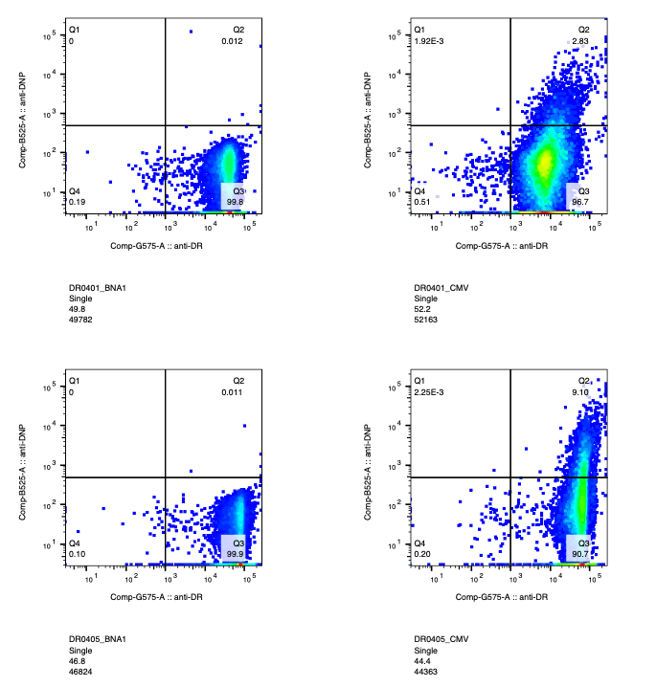
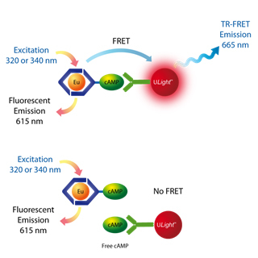
An alternative peptide binding assay...
bio-DR
DNP-CMV
Notes:
A main issue we had was that we don’t have non-bio 04:05, so we can’t use our existing peptide binding assay with bio-GAD.
So we have a TR-FRET assay planned (reagents need to come in):
We did a binding assay with different DNP-conjugated peptides and found that CMV binds well to both 04:01 and 04:05.
DNP-CMV will be the acceptor & bio-DR is the donor; both have fluorophores that need to need to be close in proximity to emit at a detectable wavelength. This allows us to more accurately measure protein binding. And we can use this for bio-DR, which is imp b/c we only have bio-form of 04:05.
Also ordered bio-CMV to test other non-bio-DR subtypes, and this might give us more trustworthy results, b/c peptides should bind with low/moderate affinity to avoid negative selection in the thymus, so some of the tau peptides that bind DR4:01 IRL might not have bound using our assay b/c GAD is a super strong binder and it’s hard for any peptide to displace it, so using a peptide like CMV that’s still a strong binder but to a lesser degree than GAD (predicted to bind 8-9 times less than GAD) might be a good idea.

Slide 23
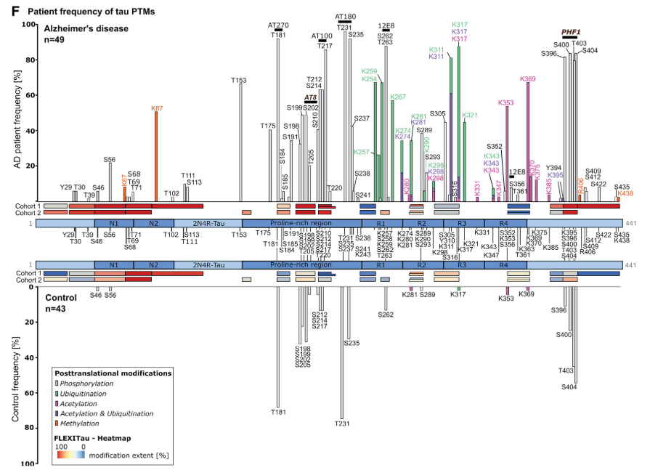
Next steps:
PTMs present in more than 50% of AD patients:
K87 (meth)
T153
T181 (high in cntl too)
S199, S202
T212, S214
T217
T231 (high in cntl too)
S235
K254, K259, K267 (ub)
S262, T263
K311 (mostly ac & ub?)
K317 (mostly ac)
K353, K369 (ac)
S396, S400, T403, S404
Wesseling, Cell Reports, 2020
Notes:
This is a graph showing the PTMs along the entire length of tau protein in AD patients and control subjects.
They found the PTMs known to be associated with cytotoxic tau and AD progression, like AT8, AT180, to be frequent in AD patients, but they also found some new PTMs that are upregulated in AD patients that haven’t really been looked into.

Slide 24
Next steps:
Test more relevant PTMs for high-binders:
Run tetramer/dextramer studies on promising peptides from peptide binding assays.
Test promising peptides with DRB1*04:05 and other non-associated HLA types.
Add 23andMe PD data to GWAS meta-analyses.
Analyze NFT density in AD/PD/FTD patients with DR4 subtypes.
tau_25 | rare: pY29, pT30, pT39
tau_425 | rare: pS435, meth-K438
tau_369 | common: ac-K369
 | rare: ac-K370, ac-K375
Notes:
There are more than 100 PTMs that are associated with tauopathies like AD, PD; we only covered ~18, so maybe we should cover more.
Here are some examples of PTMs that are associated with AD and with the strongly binding tau peptides we’ve identified so far.
It’d be good to have in vivo correlations b/w NFT density and DR4 presence to further support our hypothesis.

Slide 25
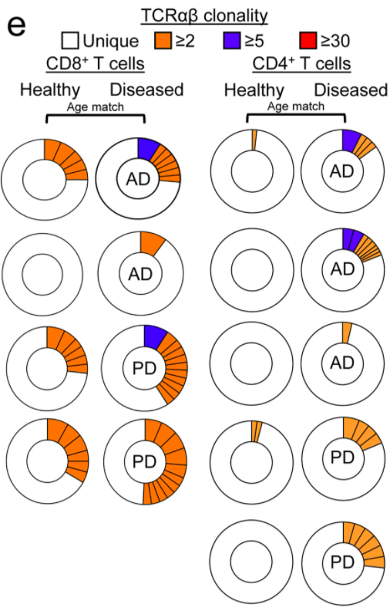
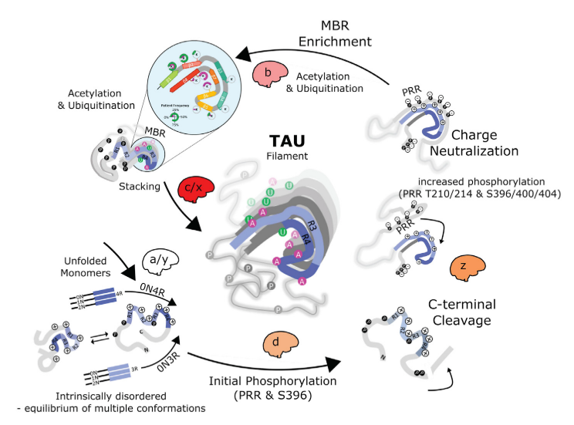
Future studies:
IHC of AD/PD/FTD hippocampal/cortical sections to look at CD4+ T cell overlap with protein aggregates (ex: tau).
Sc/TCR-seq of CD4+ T cells from PD/AD/FTD patient PBMC and CSF
Wesseling, Cell Reports, 2020
Gate et al., Nature, 2020
Notes:
It would also be really cool to see if the CD4+ T cells that infiltrate the brain in AD are capable of recognizing tau to help clearance in later stages of AD.
Inspiration from Gate’s paper: increased TCR clonality for CD4+ T cells in PD and AD CSF → maybe we can obtain the TCR sequences of the CD4+ T cells?
Once we’ve identified the TCRs that are activated by DR4:01 and peptides (whether they’re a-syn, tau, or something else implicated in AD/PD), we can compare them with the TCRs from this data to see if there’s any overlap?
Do we have access to PD/AD PBMCs and CSF- yes, through ADRC.
We’ve focused on the earlier stages of tau phosphorylation b/c that’s where most of tau PTM research is. It’s possible that DR 04:01 might recognize early phosphorylation changes in the proline-rich region and prevent tau aggregation by clearing hyperphosphorylated tau, but it’s also possible that there’s a need to start looking at the PTM changes that appear later in the disease.
I think this project overall is really interesting in how it looks into the understudied role of adaptive immunity in neurodegenerative disorders and could potentially make way for more specific therapies against tauopathies.
Thanks:
Guo, for patiently teaching me all of the techniques I would need to successfully carry out this project, and for brainstorming ways to troubleshoot through all of the issues we ran into. And for teaching me a lot of the basics of TCRs, HLAs, T cell reactivity.
Jing, for showing me where all of the lab supplies were when I needed them, and just for your lab presence.
Aditya and Vicente for working on the computational parts of this project, including running the GWAS meta-analyses to get us started on this project.
Emmanuel, for letting me rotate in the lab and for teaching me a lot of what I know about the intersections b/w adaptive immunity and neurodegenerative diseases.

